Slide 1
ANKARA ÜNİVERSİTESİ
QS Dünya Üniversite Sıralamaları 2024
Başvuru Akışı
EKİM 2023

Slide 2
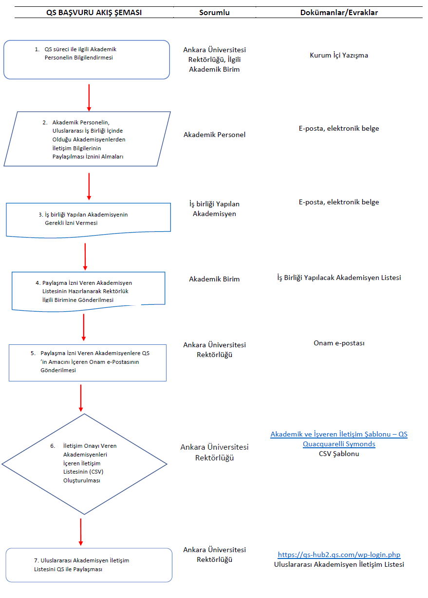
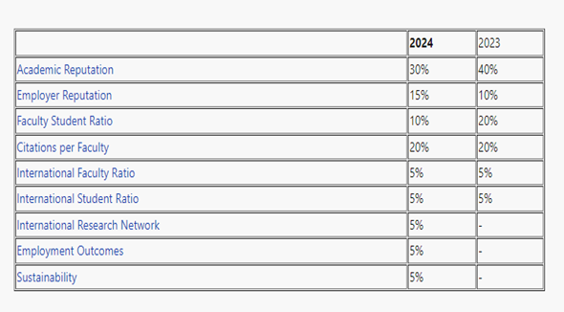
2. Adım:
PAYLAŞMA İZNİ VEREN AKADEMİSYENLERE QS’IN AMACINI İÇEREN ONAM E-POSTASI YOLLANMASI
6.
Adım: İLETİŞİM ONAYI VEREN AKADEMİSYENLERİ İÇEREN İLETİŞİM LİSTELERİ (CSV) OLUŞTURULMASI
7. Adım:
REKTÖRLÜĞÜN ULUSLARARASI AKADEMİSYEN İLETİŞİM LİSTESİNİ QS İLE PAYLAŞMASI

Slide 3
Letter:
Dear [Greeting/Name],
We are writing to you as an important stakeholder of our university. We value our ongoing engagement with you and would like to be certain that we are not using your information for any purpose that you would prefer us not to. For the purposes of an important global survey of academic/employer opinion, we would like to seek your permission to pass on your contact details (name, job title, institution and email address) to the QS. We feel that your impartial responses would contribute to the insight and precision of the survey’s outcomes.
If you consent to your contact details being passed to QS for this purpose exclusively, please reply to this email by [insert the date]. If we do not hear from you by this date, we will assume that you do not want your contact details to be passed on.
If you agree, you should be contacted by QSIU in the next few months with an invitation to participate in the annual QS Global Academic/Employer Survey, along with a maximum of two reminders. Their email will come from rankings@qs.com please add to your safe senders and check your spam.
The resulting data will be used in aggregate form only, QS will not contact you for any other reason, or for more than two editions of their annual survey, without supplementary or separate consent. Your responses will be combined with those of many others around the world to form academic/employer reputation indicators used in the QS World University Rankings at global, regional, subject and program levels where relevant. Detailed information can be found here.
Many thanks in advance for your cooperation.
Kind regards,
[Contact person]
[Job title]
[University name]

Slide 4
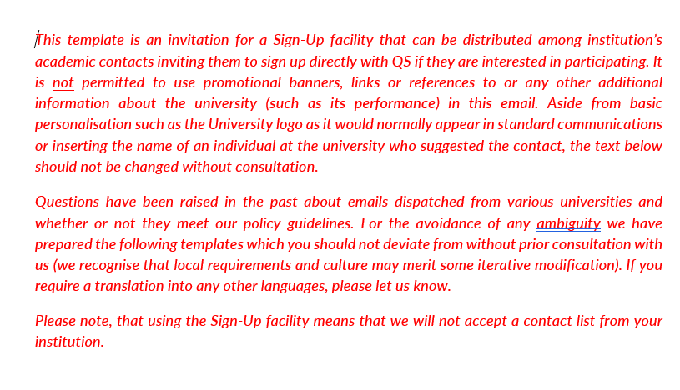
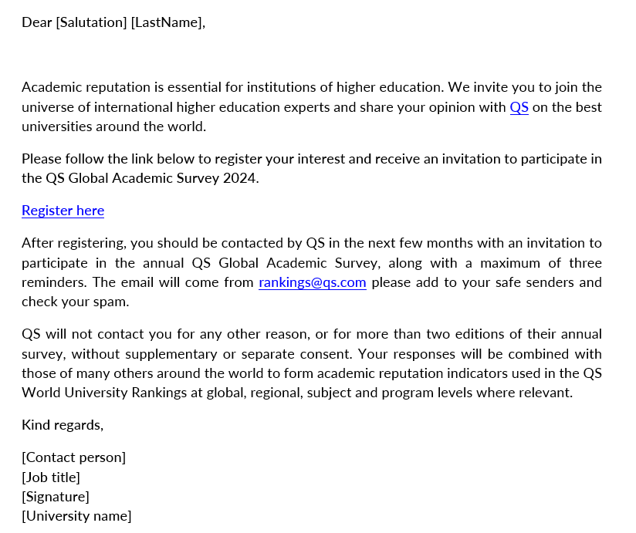
Sign-up Letters

Slide 5
ANKARA ÜNİVERSİTESİ
Bilimsel Dergilere Makale Yazma Kampı
Başvuru Raporu
EKİM 2023

Slide 6
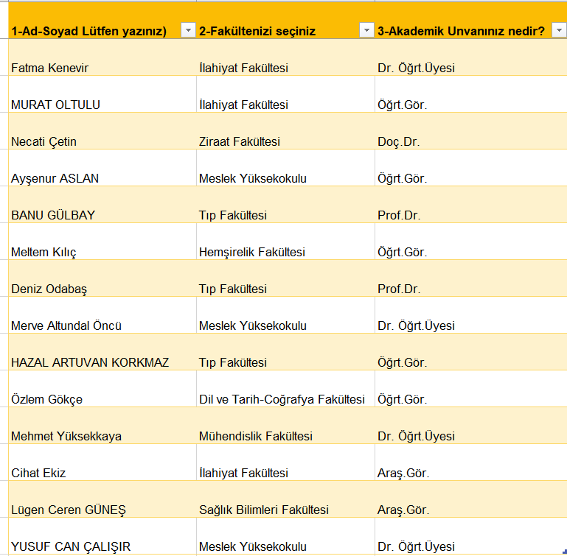
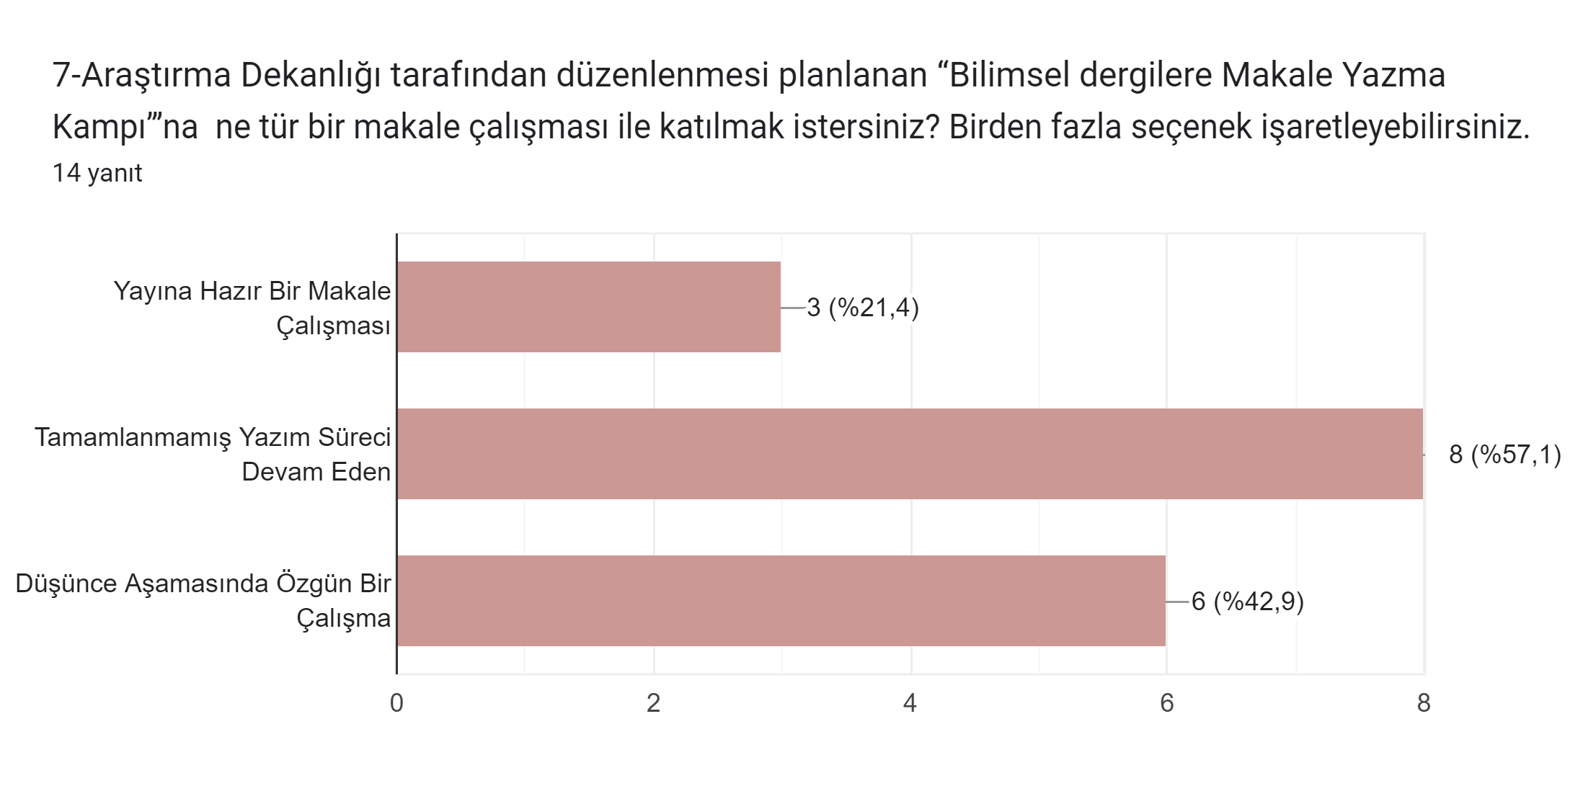
https://forms.gle/Hm1oMFy6E6GZ7mgM8

Slide 7
ANKARA ÜNİVERSİTESİ
ARAŞTIRMA YÖNTEMLERİ-İSTATİSTİK ANALİZ TEKNİKLERİ VE AKADEMİK YAZMA YETKİNLİK ANKETİ
(FEN-SAĞLIK ve SOSYAL BİLİMLER)
EKİM 2023

Slide 8
A-BİLİMSEL ARAŞTIRMA YÖNTEM ve TEKNİKLERİ ((FEN-SAĞLIK ve SOSYAL BİLİMLER)
1- Hiç deneyimli veya yetkin değilim 2- Biraz deneyimli veya yetkinim 3- Orta düzeyde deneyimli veya yetkinim 4- Oldukça deneyimli veya yetkinim 5- Çok deneyimli veya yetkinim
https://forms.gle/U697xyjVPcxMhpQu5

Slide 9
B-İSTATİSTİK ANALİZ TEKNİKLERİ(FEN-SAĞLIK ve SOSYAL BİLİMLER)
1- Hiç deneyimli veya yetkin değilim 2- Biraz deneyimli veya yetkinim 3- Orta düzeyde deneyimli veya yetkinim 4- Oldukça deneyimli veya yetkinim 5- Çok deneyimli veya yetkinim
https://forms.gle/U697xyjVPcxMhpQu5

Slide 10
C-AKADEMİK OKUMA VE YAZMA TEKNİKLERİ(FEN-SAĞLIK ve SOSYAL BİLİMLER)
1- Hiç deneyimli veya yetkin değilim 2- Biraz deneyimli veya yetkinim 3- Orta düzeyde deneyimli veya yetkinim 4- Oldukça deneyimli veya yetkinim 5- Çok deneyimli veya yetkinim
https://forms.gle/U697xyjVPcxMhpQu5

